Slide 1
X-Ray Classification
Eliyahu Rosenfeld, Guy Itzhaki
Diagnosing chest X-rays using deep learning

Slide 2



How we tackled the issue
Our goal
The initial challenge
Crucial limitations
Develop an automated system to classify X-ray chest images into distinct medical conditions.
We Received 3 folders of X-ray images.
Each folder represented an unknown medical condition.
Small Dataset: Only ~200-300 image. Limited Computing Power

Slide 3
Part 1:
Image analysis
What the diseases could be

Slide 4
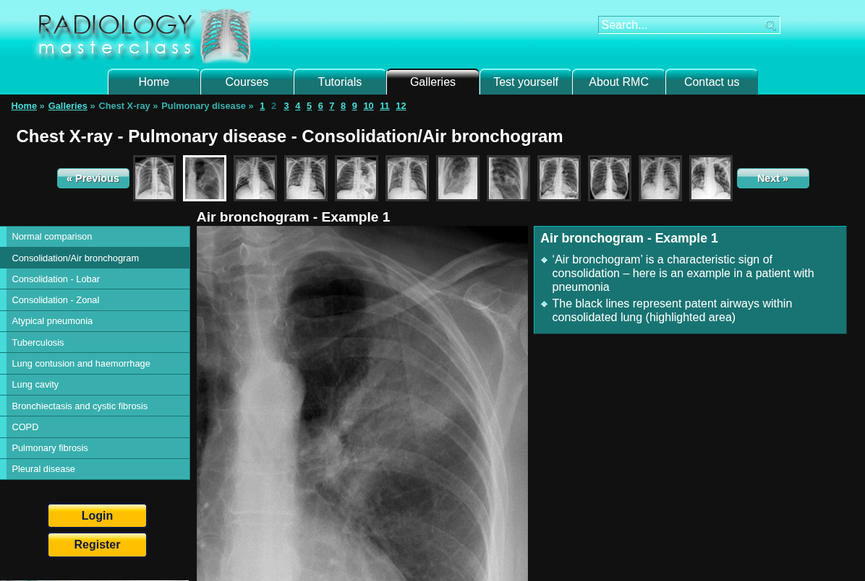
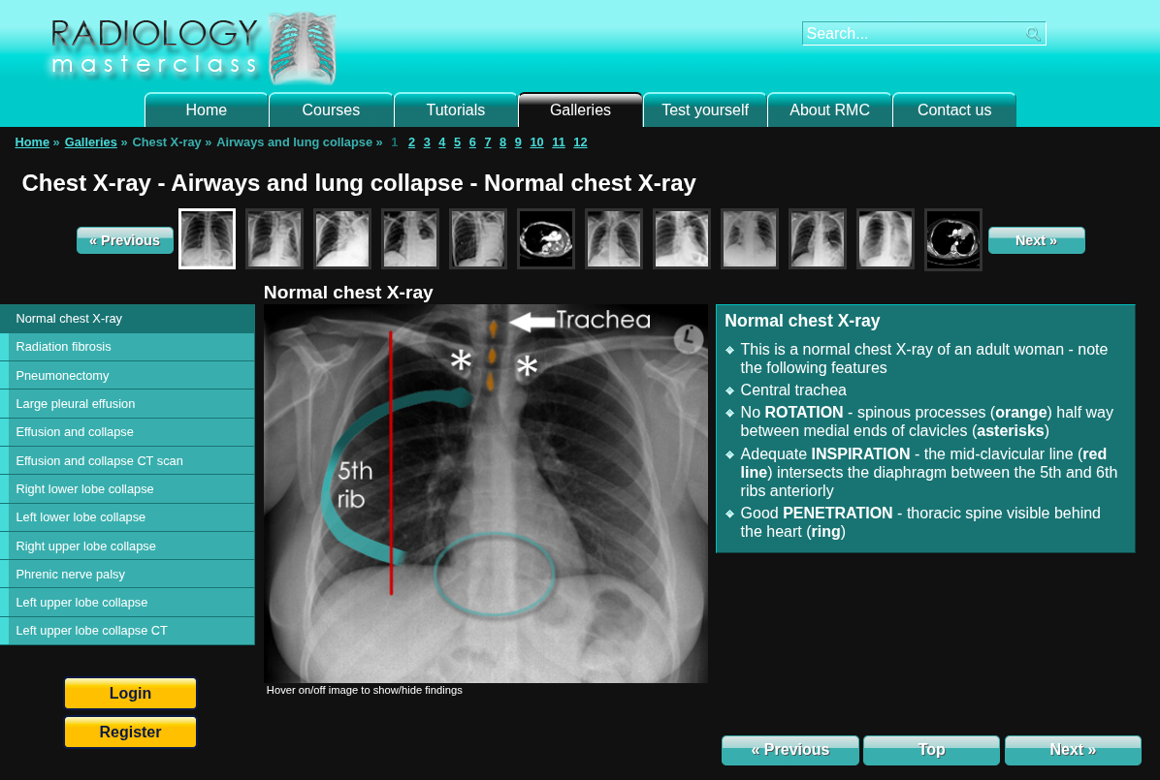
What are the images?
Better guessing, but its still guessing
Source for external Xray analysis:
https://www.radiologymasterclass.co.uk/gallery/chest/

Slide 5

What are the images?
Most images are of kids (small body)
Some of the children possibly have a history of problems
Some images create a pattern, where clear fluid or air in the lungs: fluid being more white and air being more black
Source for external Xray analysis:
https://www.radiologymasterclass.co.uk/gallery/chest/

Slide 6
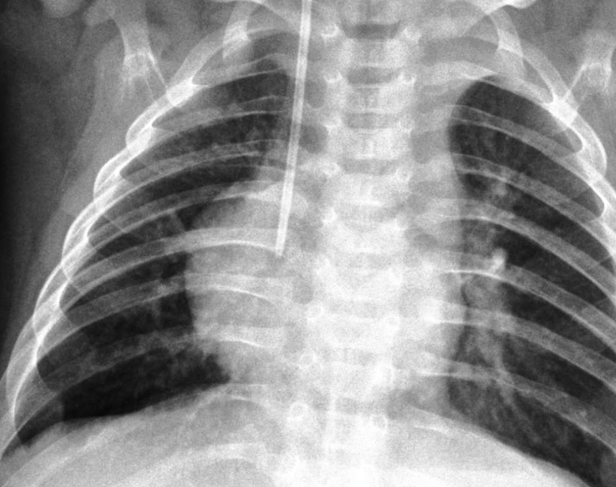
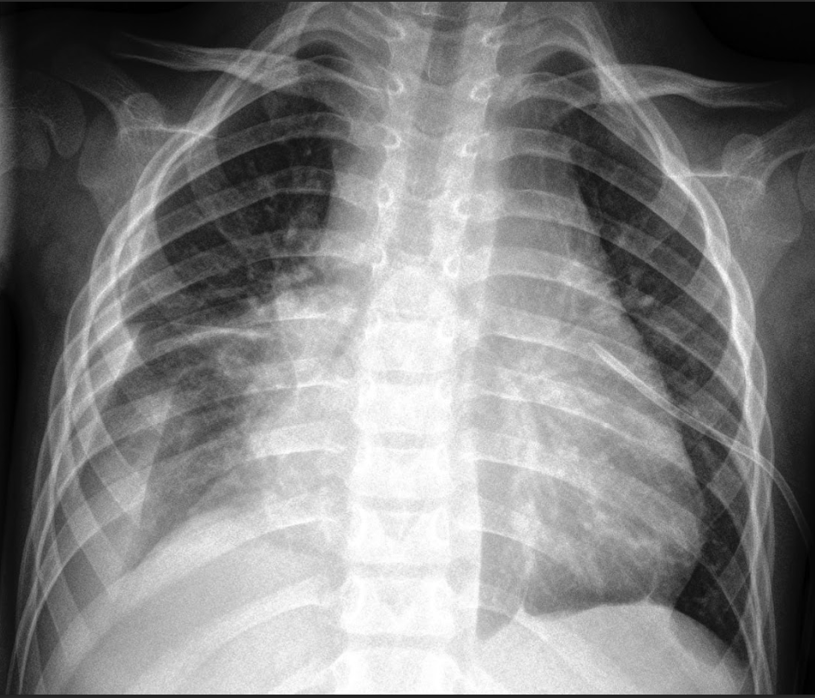
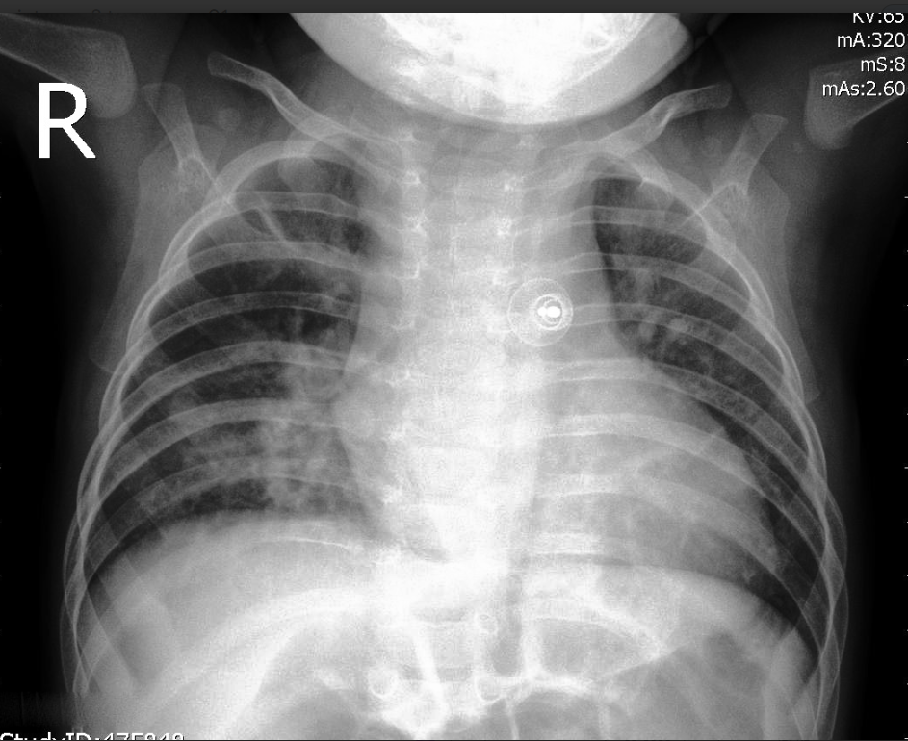
What are the images?
Possible illnesses in group 2

Slide 7
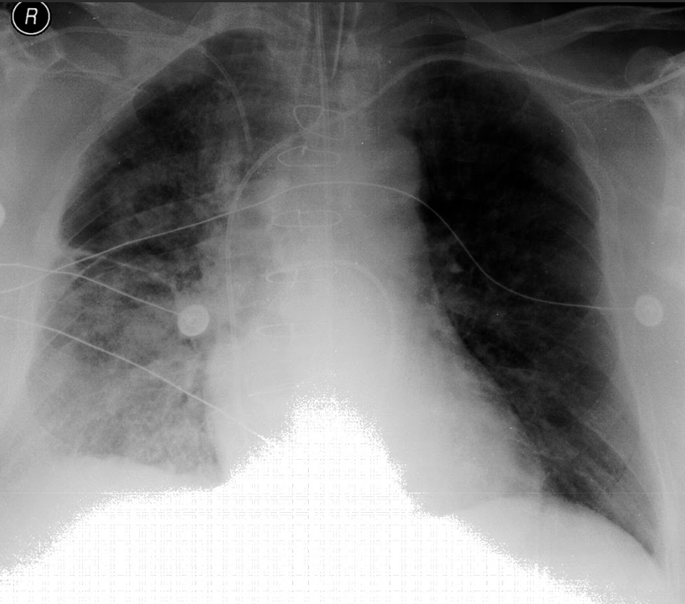
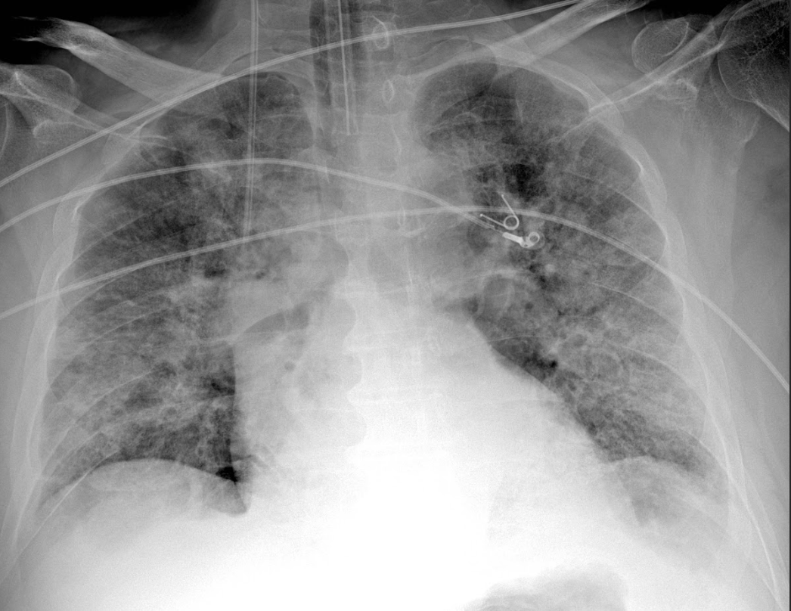
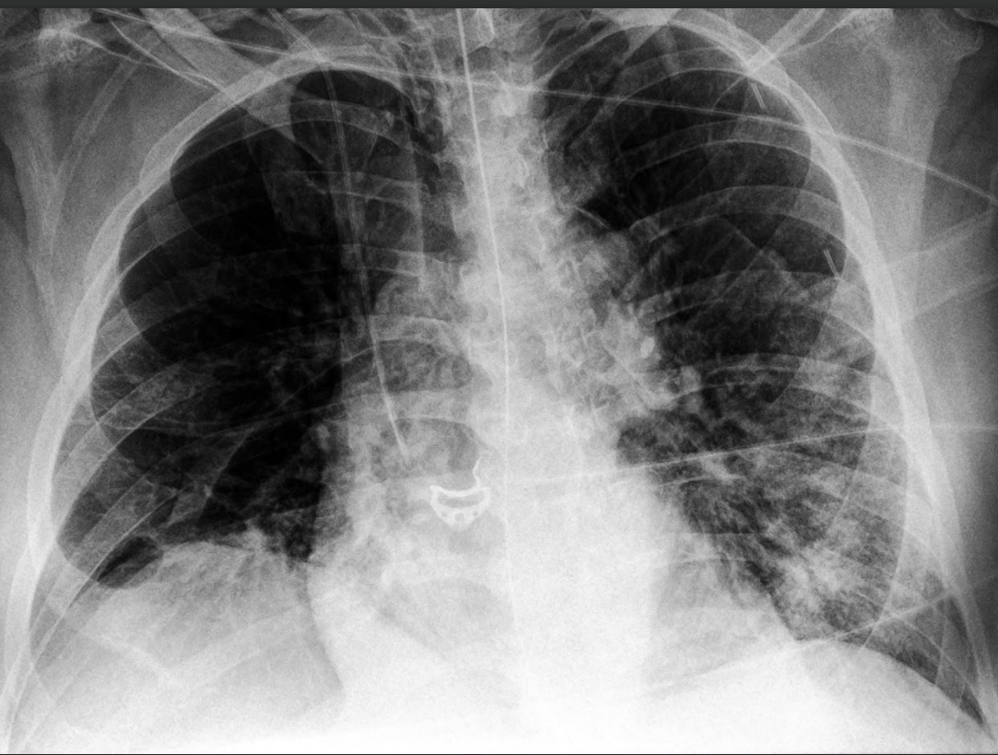
What are the images?
Basic lung analysis

Slide 8
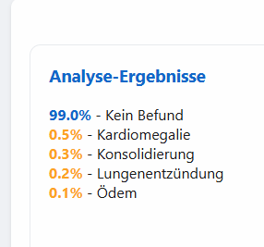
Exploring the internet
We can test our pictures in an existing networks that we found on huggingface
We will filter for Normal, Pneumonia, COVID based on results from both already existing models
Source for VIT model: https://huggingface.co/codewithdark/vit-chest-xray
Source for yassonee model: https://huggingface.co/spaces/yassonee/chest

Slide 9
Exploring the internet
The original dataset was very small. Comparing it to existing data can give us a better picture.
The new dataset has ~1.5 GB of additional images, we will use around 20,000
Kaggle datasets: https://www.kaggle.com/datasets/paultimothymooney/chest-xray-pneumonia
https://www.kaggle.com/datasets/tawsifurrahman/covid19-radiography-database

Slide 10
Part 2:
Our network
How we built our CNN

Slide 11

Transfer Learning
Choosing a network and adapting the pictures to be its’ input
Choosing layers to keep or retrain, freeze or unfreeze
Being able to “piggyback” off a successful CNN

Slide 12
Model Selection and Architecture Comparison
VGG16-BN | EfficientNet
- Simple, popular network - Batch Normalization | EfficientNet uses Compound scaling to uniformly scale the network depth, width, and resolution.

Slide 13
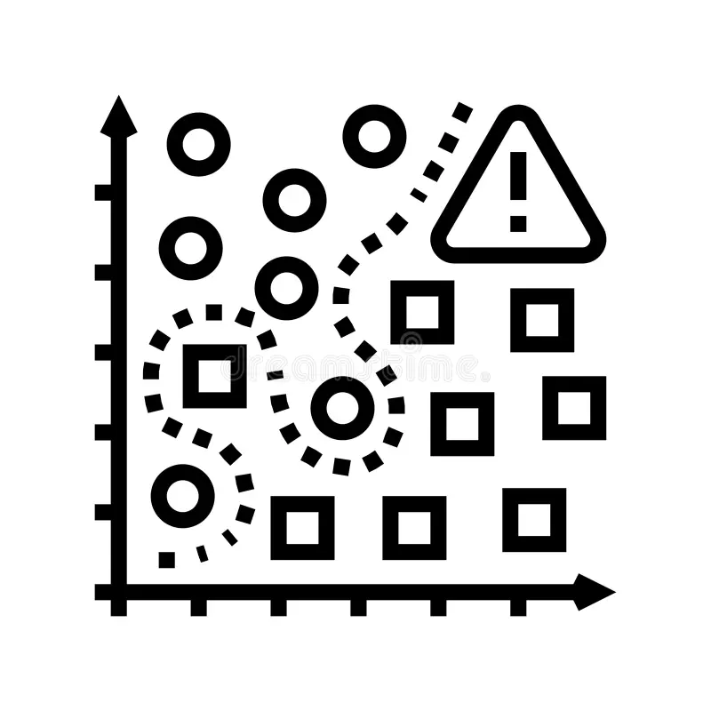
Preprocessing
Resizing to the “correct size”, introducing flip and rotation (Augmentation). Also Added pixel normalization so the values fit the network.

Slide 14

Optuna
Optuna intelligently searched for the best combinations of:
Learning Rate (lr)
Batch Size (batch_size)
Dropout Rate (dropout_rate)
Number of Epochs (num_epochs)

Slide 15
Part 3:
Results and more
Identifying the pictures, and presenting our findings

Slide 16


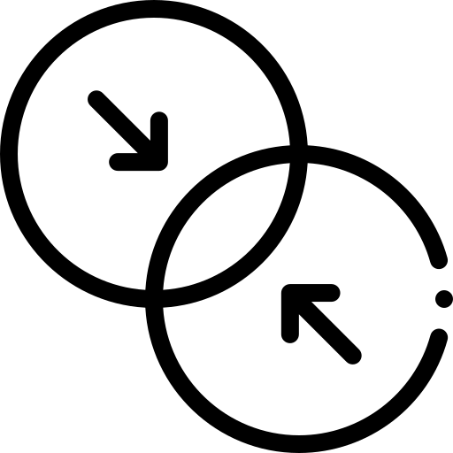
Experimental Setup & Data Splits
We agreed to:
Our Data
External Data
Combined
Training Set (60%)
Validation Set (20%)
Test Set (20%)
Original Data Only:
Our initial, smaller dataset (after identifying classes).
Kaggle/Expanded Data Only: The large public datasets we acquired.
Original + Kaggle Data: The combined, largest dataset available.
These Categories can be done in VGG or EfficientNet

Slide 17
Results & Discussion (Test)
VGG16-BN (Original + Kaggle Combined Data):
Accuracy: 0.9657
Precision (weighted): 0.9666
Recall (weighted): 0.9657
F1-Score (weighted): 0.9655
EfficientNet-B3 (Original + Kaggle Combined Data):
Accuracy: 0.9822
Precision (weighted): 0.9824
Recall (weighted): 0.9822
F1-Score (weighted): 0.9821

Slide 18

Key Findings, Best results
Using the original data to get the best results (small test size), although all options work
Using EfficientNet for slightly better results, in relevant statistical metrics

Slide 19
Thanks for listening!!
Demonstration: https://xray-chest-classification.streamlit.app/
We would love to answer any questions ☺

